Slide 1
50-State Revocation Study
Preliminary Findings
DRAFT for Arnold Ventures Board Only; DO NOT CITE OR DISTRIBUTE

Slide 2
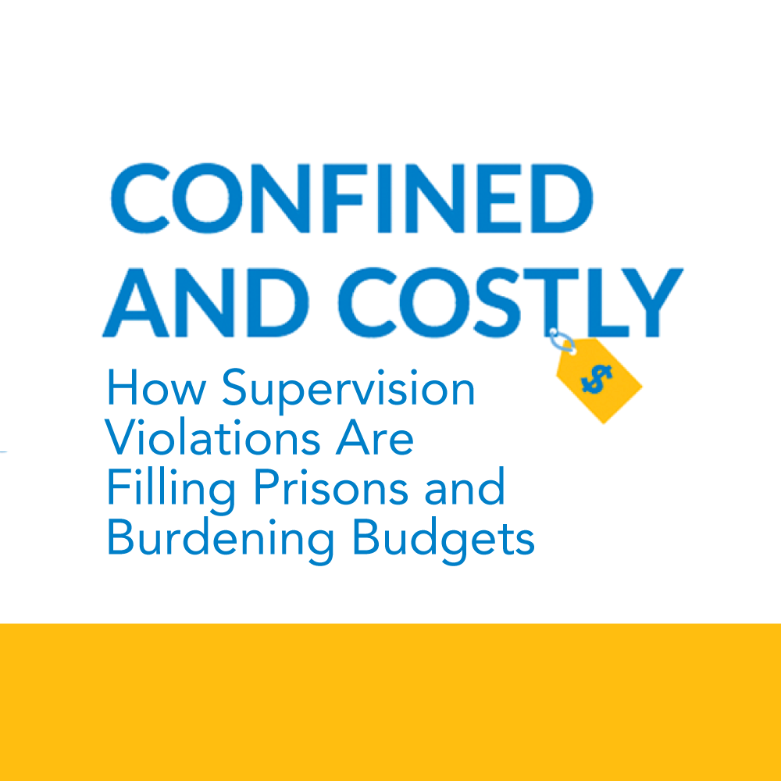
50-State Revocation Study Introduction
All findings are PRELIMINARY and still need to go through a quality assurance review. Please do not cite, quote, or distribute until they have been finalized.
Background: Confined & Costly, published in 2019, found that 45% of prison admissions were due to supervision violations, varying greatly by state.
Current Study: Three-year study that (1) Develops routinized data collection, (2) Provides in-depth analysis of supervision violations in three states, and (3) helps build states’ capacity to understand impact of supervision violations on their prison populations

Slide 3
Study Timeline and Progress for Year 1
All findings are PRELIMINARY and still need to go through a quality assurance review. Please do not cite, quote, or distribute until they have been finalized.
Task | Progress
50-State Survey | Survey all 50 states from July to October 2020 Received responses from 45 states (and supplemented with other data sources) Analysis in progress (including vetting numbers with states) Results will be published and disseminated in 2021 through: National Research Brief; State Analysis Brief; Stakeholder Review; Development of Dissemination Plan; Virtual event; State Video
Supervision Revocation Deep Dive #1 | Received approval to conduct study in GA Data request and IRB review in progress Results anticipated in Spring/Summer 2021

Slide 4
Eighty-six percent of states provided complete admissions information for the survey time period
All findings are PRELIMINARY and still need to go through a quality assurance review. Please do not cite, quote, or distribute until they have been finalized.
AK
ME
43 states provided admission numbers for people who violated supervision
2 states did not break out admissions numbers or did not provide all three years
3 states required supplemental information from publicly available data
2 states did not provide updated admissions information
States Reporting Prison Admissions Information for 2017—2019
VT
NH
WA
MT
ND
MN
WI
MI
NY
MA
RI
ID
WY
SD
IA
IL
IN
OH
PA
NJ
CT
OR
NV
UT
NE
MO
KY
WV
MD
DE
CA
AZ
CO
KS
AR
TN
VA
NC
NM
OK
LA
MS
AL
SC
TX
GA
HI
FL

Slide 5
Seventy-eight percent of states provided complete population information for the survey time period
All findings are PRELIMINARY and still need to go through a quality assurance review. Please do not cite, quote, or distribute until they have been finalized.
AK
ME
States Reporting Prison Population Information for FY2018—2019
38 states provided population numbers for people in prison on supervision violations
3 states did not break out population numbers
1 state required supplemental information from publicly available data
8 states did not provide updated population information
VT
NH
WA
MT
ND
MN
WI
MI
NY
MA
RI
ID
WY
SD
IA
IL
IN
OH
PA
NJ
CT
OR
NV
UT
NE
MO
KY
WV
MD
DE
CA
AZ
CO
KS
AR
TN
VA
NC
NM
OK
LA
MS
AL
SC
TX
GA
HI
FL

Slide 6
All but 11 states submitted some survey information for 2020*
All findings are PRELIMINARY and still need to go through a quality assurance review. Please do not cite, quote, or distribute until they have been finalized.
AK
ME
36 states reported some 2020 admissions information for people who violated supervision
3 states reported 2020 admissions information but did not break out people with violations
11 states reported no 2020 information
States Reporting 2020 Admissions Information
VT
NH
WA
MT
ND
MN
WI
MI
NY
MA
RI
ID
WY
SD
IA
IL
IN
OH
PA
NJ
CT
34 states shared some 2020 population information on people who violated supervision
AK | IL | NC | SC
AL | IN | ND | UT
AR | KS | NH | VT
CA | MA | NV | WA
CO | MD | NY | WI
FL | MI | OK | WV
HI | MN | OR | WY
IA | MO | PA
ID | MT | RI
OR
NV
UT
NE
MO
KY
WV
MD
DE
CA
AZ
CO
KS
AR
TN
VA
NC
NM
OK
LA
MS
AL
SC
TX
GA
HI
FL

Slide 7
Caution: Data is not always comparable
All findings are PRELIMINARY and still need to go through a quality assurance review. Please do not cite, quote, or distribute until they have been finalized.
States define admissions and populations of the supervision violator population differently
Some states reported they include quick dips and supervision sanctions in their admissions numbers, some do not
Some states reported they classify new felony offenses as technical violations, some do not
States do not necessarily have the infrastructure or institutional memory to pull data in a consistent way over time
When provided opportunity, 19 states revised old data
We expect a similar number may revise their survey responses during validation process

Slide 8
The states that revised the numbers they previously provided in 2017 reported 5,415 fewer violations
All findings are PRELIMINARY and still need to go through a quality assurance review. Please do not cite, quote, or distribute until they have been finalized.
VT acquired the ability to report admissions for violations

Slide 9
Caution: These numbers come directly from the survey, we have not vetted them yet
All findings are PRELIMINARY and still need to go through a quality assurance review. Please do not cite, quote, or distribute until they have been finalized.
Some numbers surprised us
Reported numbers do not always align with our knowledge of system trends
However, early validation checks using publicly-available data confirm survey accuracy
Our unique position will allow us to get state leaders to review their own state profiles to confirm/update data
Current status: Developing state-specific reports to send to our contacts in all 50 states after Thanksgiving holiday

Slide 10
According to survey results: Most states saw decreases in the number of people admitted for supervision violations
All findings are PRELIMINARY and still need to go through a quality assurance review. Please do not cite, quote, or distribute until they have been finalized.
AK
ME
Changes in Admissions for supervision violations, 2017—2019
29 states saw decreases in the number of people admitted for supervision violations.
15 states saw increases in the number of people admitted for supervision violations.
6 states did not provide complete information for these admissions
VT
NH
WA
MT
ND
MN
WI
MI
NY
MA
RI
ID
WY
SD
IA
IL
IN
OH
PA
NJ
CT
OR
NV
UT
NE
MO
KY
WV
MD
DE
CA
AZ
CO
KS
AR
TN
VA
NC
NM
OK
LA
MS
AL
SC
TX
GA
HI
FL

Slide 11
According to survey results: Across 44 states, there were a total of 15,924 fewer admissions for supervision violations in 2019 compared to 2017
All findings are PRELIMINARY and still need to go through a quality assurance review. Please do not cite, quote, or distribute until they have been finalized.
Large differences in MO and AL tentatively confirmed using alternative data sources

Slide 12
Twenty states experienced a decrease in admissions to prison for supervision violations by more than 5%
All findings are PRELIMINARY and still need to go through a quality assurance review. Please do not cite, quote, or distribute until they have been finalized.
Change in Population

Slide 13
Ten states experienced an increase in admissions to prison for supervision violations by more than 5%
All findings are PRELIMINARY and still need to go through a quality assurance review. Please do not cite, quote, or distribute until they have been finalized.
Change in Population

Slide 14
According to the Survey: Fewer than half of states saw decreases in the population of people who violated supervision
All findings are PRELIMINARY and still need to go through a quality assurance review. Please do not cite, quote, or distribute until they have been finalized.
AK
Changes in Supervision Violator Population, 2018—2019
ME
22 states saw decreases in this population
16 states saw increases in this population
12 states did not provide information on this population
VT
NH
WA
MT
ND
MN
WI
MI
NY
MA
RI
ID
WY
SD
IA
IL
IN
OH
PA
NJ
CT
OR
NV
UT
NE
MO
KY
WV
MD
DE
CA
AZ
CO
KS
AR
TN
VA
NC
NM
OK
LA
MS
AL
SC
TX
GA
HI
FL

Slide 15
According to survey: There were 7,863 fewer people in prison on supervision violations at the end of June 2019 compared to end of June 2018
All findings are PRELIMINARY and still need to go through a quality assurance review. Please do not cite, quote, or distribute until they have been finalized.
VA has already indicated they will be revising their 2019 figure
Change in Population
Difference in MO tentatively confirmed

Slide 16
Ten states reported a decreased in their supervision violation population more than 5%
All findings are PRELIMINARY and still need to go through a quality assurance review. Please do not cite, quote, or distribute until they have been finalized.
Change in Population

Slide 17
Nine states reported increases in their supervision violation populations by more than 5%
All findings are PRELIMINARY and still need to go through a quality assurance review. Please do not cite, quote, or distribute until they have been finalized.
Change in Population

Slide 18
According to the Survey: Admissions for supervision violations were lower in FY2020 than in FY2019 in 8 of 9 states who provided data
All findings are PRELIMINARY and still need to go through a quality assurance review. Please do not cite, quote, or distribute until they have been finalized.
States with Complete Data | Change in Admissions for Supervision Violations | % Difference | Change in Admissions for New Court Commitments | % Difference
FL | -3,312 | - 29% | -4,272 | - 21%
HI | -263 | - 9% | -1,849 | - 34%
IA | -255 | - 10% | -551 | - 16%
KS | -1,483 | - 34% | -432 | - 21%
MD | -626 | - 32% | -1,709 | - 32%
MN | -982 | - 22% | -588 | - 22%
MT | -70 | - 8% | -288 | - 18%
VT | +10 | +3% | -1,285 | - 17%
WY | -139 | - 22% | -99 | - 20%

Slide 19
Further investigation is needed to determine whether significant changes in violation admissions occurred in 2020
All findings are PRELIMINARY and still need to go through a quality assurance review. Please do not cite, quote, or distribute until they have been finalized.
Population

Slide 20
Next Steps
All findings are PRELIMINARY and still need to go through a quality assurance review. Please do not cite, quote, or distribute until they have been finalized.
50-State Survey:
Validate survey results with state leaders
Update financial figures using state-provided costs
Supplement 2020 data with publicly available information on revocations
Disseminate takeaways per communications plan
State-Specific Analysis:
Submitted data request to Georgia on October 21
Anticipate Institutional Review Board approval by end of November

Slide 21
Thank You!
For more information, please contact Jess Saunders at jsaunders@csg.org.

